Slide 1
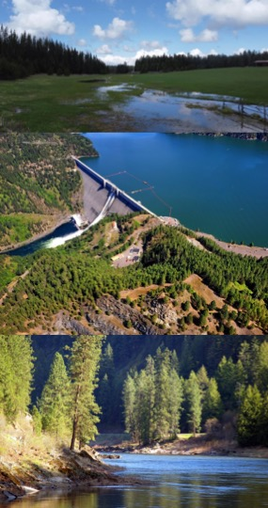





Incorporating Nutrient and Heat Flow into River and Watershed Modeling to Better Predict Ecological Response across Large Scales
Next Generation Ecological Modeling Tools Seminar Series
February 14, 2024
Engineer Research and Development Center (ERDC)
U.S. Army Corps of Engineers (USACE)
Todd Steissberg
Isaac Mudge
Kelsey Walak
LimnoTech
Anthony Aufdenkampe
Sarah Jordan
Jason Rutyna
Xavier Nogueira
Billy Johnson

Slide 2
Motivation and Background
Todd

Slide 3
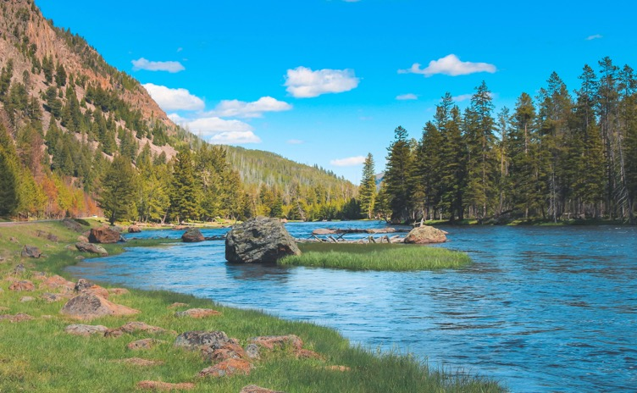
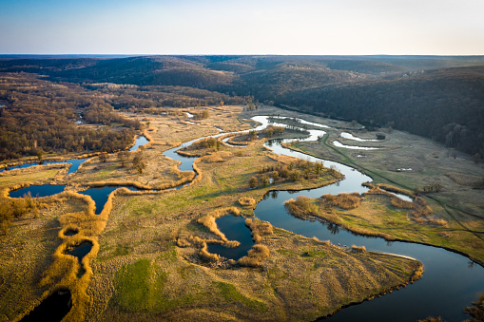
Introduction: Nutrient Flow through Ecosystems
Nutrient flow through ecosystems has a profound impact on how species utilize resources across watershed scales.
Primary production
Species distribution and abundance
Ecosystem productivity and stability
Community composition and diversity
Carbon sequestration
Notes:
Photo 1: Yellowstone National Park, showing complexity of landscape, flow, and vegetation
Photo 2: Complex and meandering flow across a landscape

Slide 4
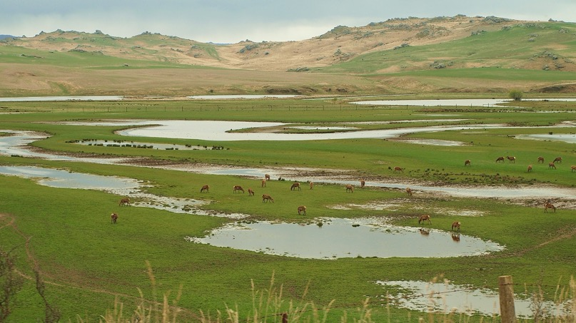
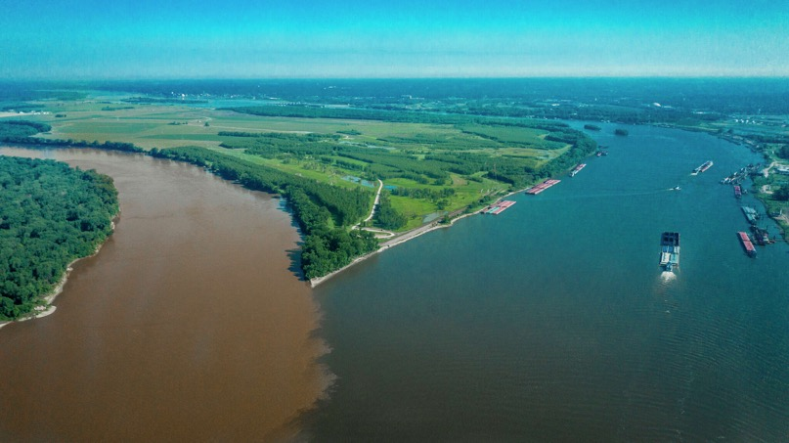
Introduction: Nutrient Flow and Disturbances
Human-caused disturbances are disrupting nutrient cycling
This causes cascading effects on ecosystem health and functioning.
The most common issue is nutrient excess:
Causes
Agricultural runoff
Urbanization (stormwater)
Industrial discharge
Effects
Rapid algae growth
Oxygen depletion
Harmful toxins

Slide 5
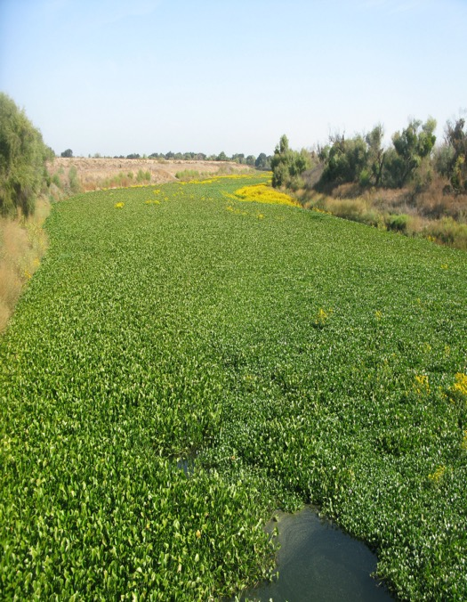
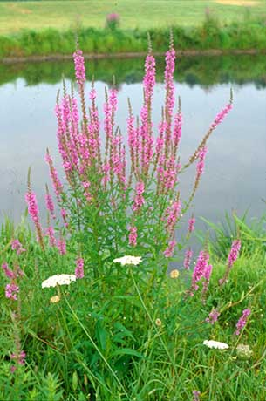
Introduction: Nutrient Flow and Invasive Species
Invasive species can take advantage of changes in nutrient dynamics
Nutrient-rich watersheds promote invasive aquatic plants, outcompeting native species.
Excess nutrients stimulate algal blooms, providing invasive species with abundant food sources.
Disrupted trophic interactions due to nutrient imbalances favor invasive predators over native prey.
Nutrient-enriched soils create favorable conditions for invasive plant colonization.
Notes:
Photo 1: Invasive water hyacinth, Sacramento River
Photo 2: Purple loosestrife, an invasive plant species of wetlands. Photo credit: Scott Jackson

Slide 6
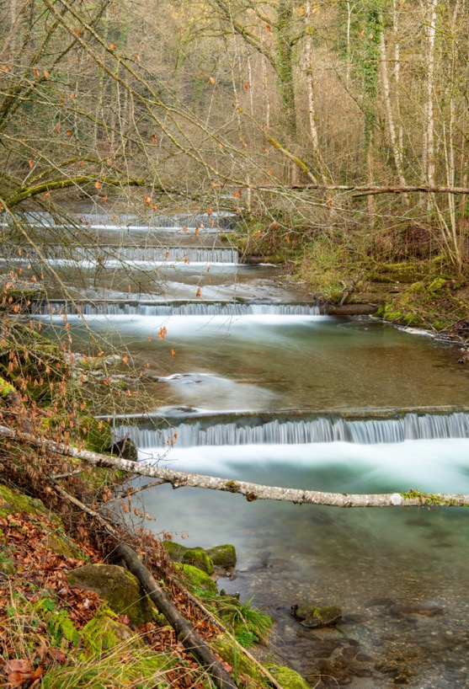
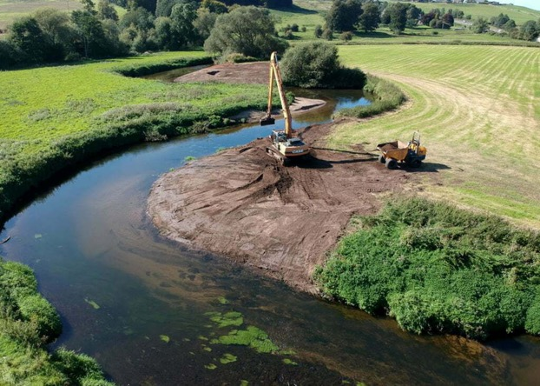
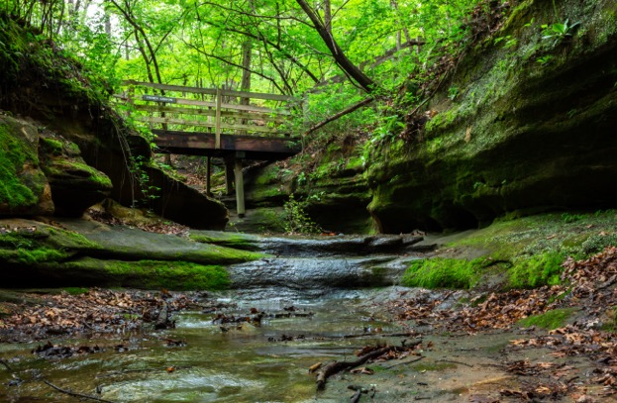
Introduction: Simulation of Nutrient Flow at Watershed Scales
Nutrient flow through ecosystems was not being simulated across watershed scales using a flexible integrated modeling system.
This hindered our ability to:
Assess ecosystem risk analysis
Predict morbidity and mortality of key species
Predict spatial distribution of species across landscapes in response to changing conditions
Identify effective ecosystem restoration strategies and management interventions
Design measures to control the spread of invasive species
Notes:
Photo 1: Terraced stream restoration project
Photo 2: River restoration, Trent River Valley, England

Slide 7



Introduction: Project Objective
Develop an integrated ecohydrology modeling system that simulates heat and nutrient flow through ecosystems.
Water Resources Models
Water Quality Models (Nutrients & Temperature)
Ecological Models

Slide 8
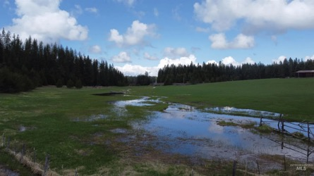
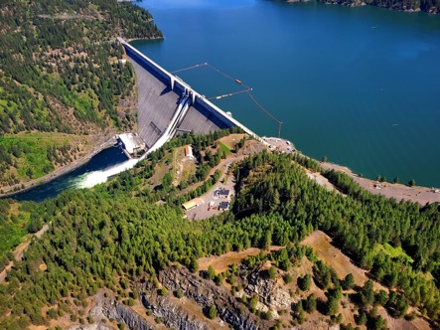
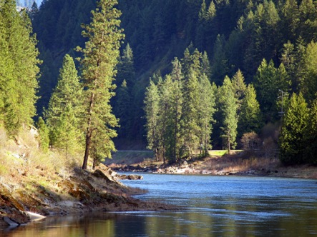
ERDC Environmental Modeling Capabilities
Linking environmental models with existing water resources models streamlines workflows and reduces costs. These simulate runoff, rivers, and reservoir hydraulics and hydrology
Our team at USACE-ERDC has developed ClearWater (Corps Library for Environmental Analysis and Restoration of Watersheds).
ClearWater provides environmental simulation capabilities with a suite of packages that are designed to leverage existing water resources models.
ClearWater modules simulate water quality constituent kinetics, and heat budget processes. Capabilities include:
Nutrients: Nitrogen, phosphorus, carbon, dissolved oxygen, algae, etc.
Temperature (heat budget)
General Constituents
ClearWater-Riverine computes transport (advection and diffusion) of heat and constituent mass using outputs from any 2D hydrologic or hydrodynamic model
Data visualization capabilities
Framework to couple multiple models
Legacy Fortran modules integrated with HEC-RAS and HEC-ResSim
New Python modules and were developed to support 2D river-floodplain modeling
Runoff
Reservoirs
Rivers
Notes:
Water quality modeling capabilities have advanced significantly, particularly in streamlining workflows and reducing costs by linking water quality (WQ) capabilities with existing hydrologic or hydraulic (H&H) models. The U.S. Army Corps of Engineers (USACE) has been at the forefront of developing widely deployed models that simulate watershed runoff, river hydraulics, and reservoir operations. To further enhance these capabilities, the USACE-ERDC (Engineer Research and Development Center) team has developed a modular library of environmental modeling capabilities, including the standalone river WQ model called ClearWater-Riverine.
ClearWater (Corps Library for Environmental Analysis and Restoration of Watersheds) is specifically designed to integrate environmental simulation capabilities with existing H&H models. It offers a range of modules that encompass various aspects of water quality dynamics and vegetation simulation. These modules simulate:
1. Nutrients – simulates the transport and transformation of nutrients within the river-reservoir system. They consider processes such as nutrient loading, uptake by algae, nutrient cycling, and water-column interactions.
2. Temperature – simulates heat budget dynamics, considering factors such as solar radiation, air temperature, and streamflow. It helps assess thermal impacts on water quality and aquatic ecosystems.
3. General Constituents - simulates a wide range of water quality constituents, such as dissolved oxygen, pH, turbidity, or specific pollutants. It enables the assessment of various water quality parameters relevant to specific modeling objectives.
4. Contaminants – simulates the fate and transport of contaminants, including pollutants or toxic substances. It aids in assessing the potential impacts of contaminants on water quality, ecological health, and human health.
5. Mercury – simulates the transport and fate of mercury in river-reservoir systems. It helps evaluate the fate and behavior of this toxic element and its potential impacts on water quality and ecosystems.
ClearWater includes a comprehensive water quality engine that computes the transport of heat and mass (including nutrients, contaminants, and other constituents) across the watershed. The model considers advection and diffusion processes, reflecting the movement and dispersion of pollutants or other water quality parameters.
Data visualization and reporting capabilities were developed to enable users to visualize and analyze water quality and environmental model results effectively. The integration of these capabilities into a comprehensive water quality framework ensures seamless interaction between the different modeling components, allowing for the development of comprehensive river-reservoir water quality models.
USACE-ERDC's ClearWater-Riverine model and the associated library of environmental modeling capabilities significantly enhance water quality modeling capabilities. By integrating water quality considerations into existing hydrologic and hydraulic models, these advancements support more comprehensive and efficient analysis of water resources, facilitating informed decision-making and effective management of river-reservoir systems.

Slide 9
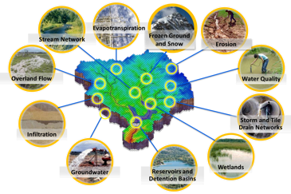
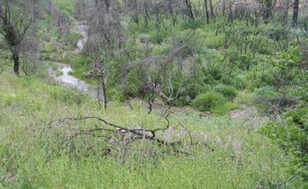
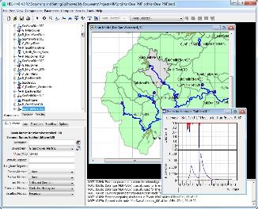
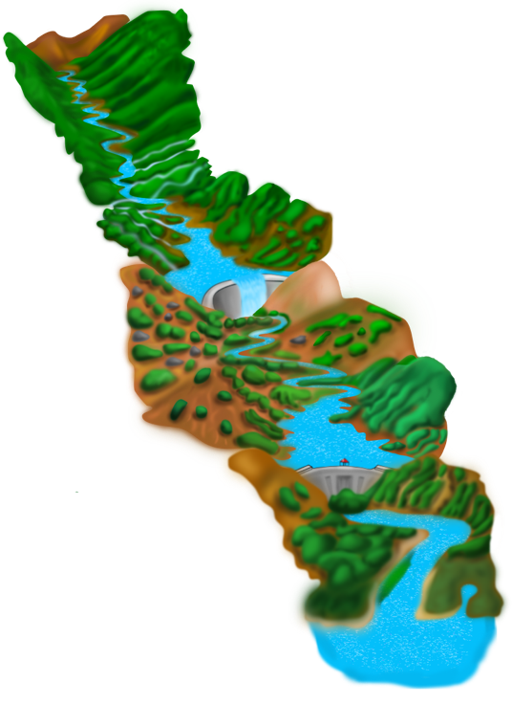
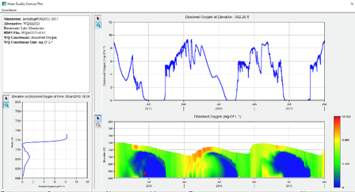
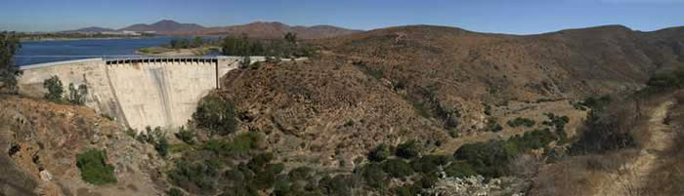
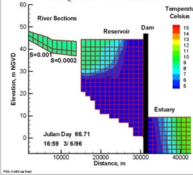
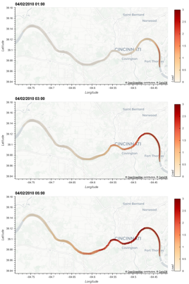
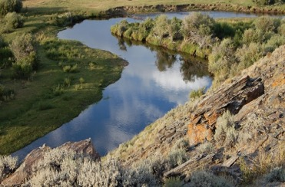
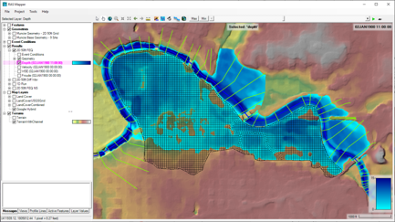
Water Quality and Environmental Systems Modeling
Temperature
Nutrients
Dissolved Oxygen
Algae
Metals
Contaminants
ERDC’s Corps Library for Environmental Analysis and Restoration of Watersheds (ClearWater) provides environmental simulation capabilities that leverage existing hydrologic and hydraulic (H&H) models.
Water quality modeling tools:
Watershed Runoff:
GSSHA: Surface and sub-surface water quality modeling
HEC-HMS: Surface runoff temperature modeling
Reservoirs:
CE-QUAL-W2: 2D reservoir-river hydrodynamics and water quality modeling
HEC-ResSim: Reservoir operations and water quality modeling
Rivers and Floodplains:
HEC-RAS: 1D River hydraulics and water quality & vegetation modeling
ClearWater-Riverine: 2D River-floodplain hydraulics and water quality modeling with HEC-RAS-2D
Estuary
Key:
ERDC
HEC

Slide 10
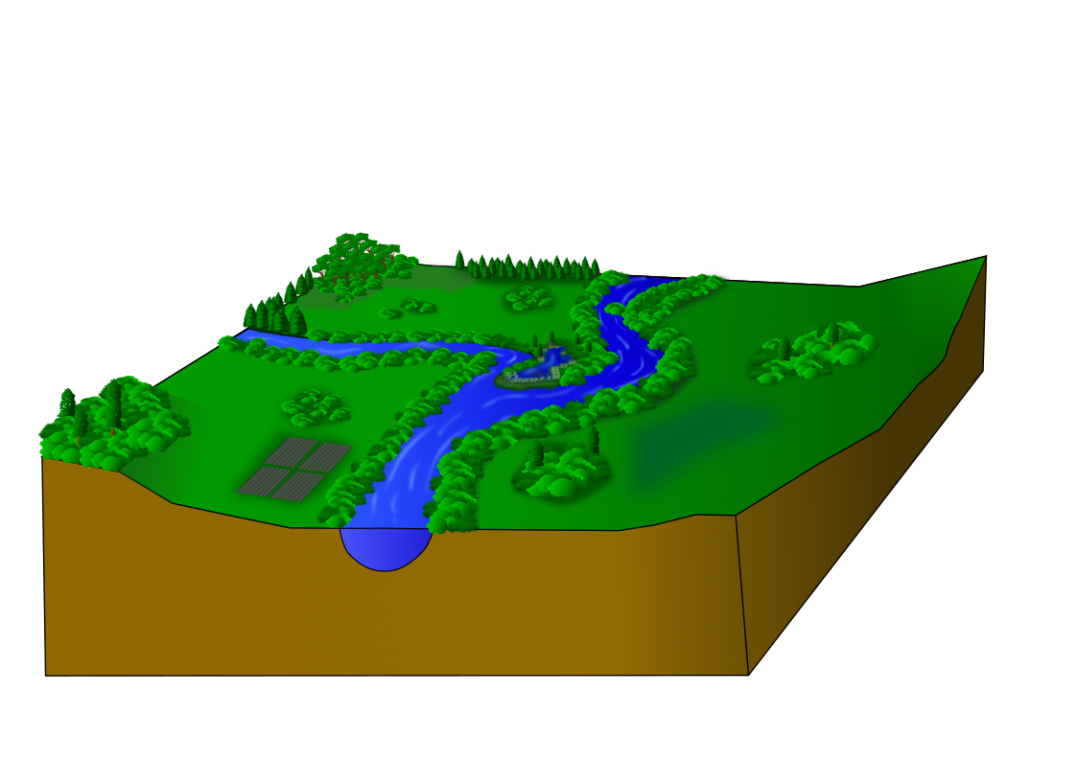

Model Dimensions: River-Floodplain System
Unstratified river channels are often modeled as one-dimensional (1D) water bodies, varying from upstream to downstream
Hydrologic connectivity across the floodplain is important
Floodplains need to be modeled as two-dimensional (2D) water bodies, varying in all directions across the landscape
2D River (Floodplain, Wetlands)
1D River (Channel)
Graphics by Lauren Melendez

Slide 11
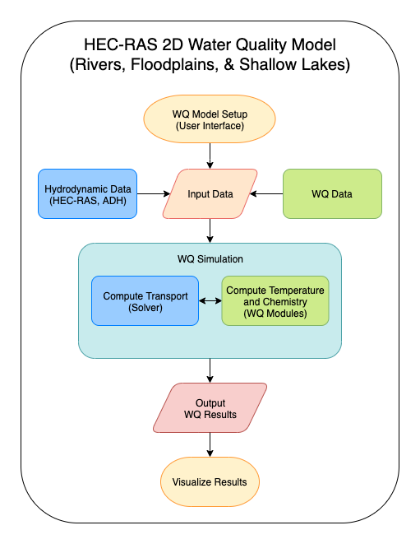
ClearWater-Riverine: 2D Water Quality Modeling with HEC-RAS and GSSHA
ClearWater Modules:
Compute heat budget and constituent kinetics for a single cell
ClearWater Engine:
Computes advection-diffusion across the model grid at each time step
ClearWater Framework:
Links water quality and ecological models with water resources models
Controls
Model input and output
Time steps (computational, input, and output)
Simulation of transport across the model grid
Coordinates engine, modules, and data
Inputs
Volumetric flows, velocities, depths
Model grid (bathymetry)
Observed meteorology and water quality time series
Outputs
Time series of 2D water quality grids, one time series per variable
Time series of simulated hydrodynamic and water quality data at user-selected locations
2D Water Quality Model
Notes:
EMRRP funded HEC-RAS water quality (1D) and ClearWater-Riverine (linked with HEC-RAS-2D).
The Next Generation Ecological Modeling project funded expanding ClearWater-Riverine to support linking with GSSHA and ecological models.

Slide 12
Developing Python versions of TSM & NSM
Isaac and Kelsey

Slide 13
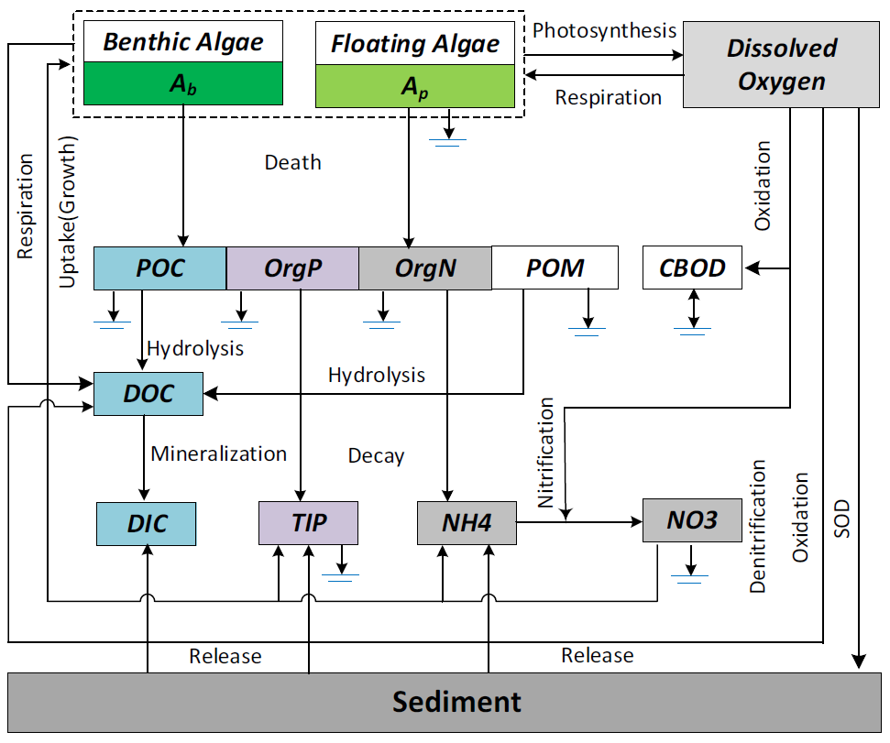
Nutrient Simulation Module (NSM) Processes
Zhang & Johnson, 2016
Notes:
Relevance to ecology: spatial patterns of dissolved oxygen, algal carbon production, nutrient control of plant growth.

Slide 14


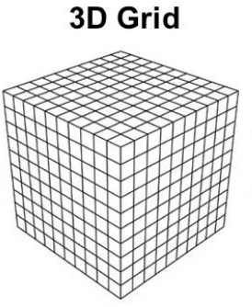
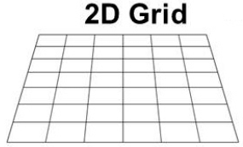
Developing new Python-based Modules
Legacy NSM and TSM written in Fortran
New versions of NSM and TSM written in Python
Single cell calculations
Python framework will iterate computations for multiple cells
Notes:
Adopted algorithms from legacy versions of NSM and TSM, porting from Fortran to Python
Focus on calculating a single cell and single timestep
Reaction calculations only need to know state variables (concentrations, temperature, etc.) in that cell at that time.
Then convert to modern Python framework to extend calculations in multiple dimensions, handle I/O, and couple with other models
Anthony will describe this in more detail below

Slide 15
Temperature Simulation Module (TSM) Processes
Zhang & Johnson, 2016
Notes:
Relevance to ecology: spatial patterns of dissolved oxygen, algal carbon production, nutrient control of plant growth.

Slide 16
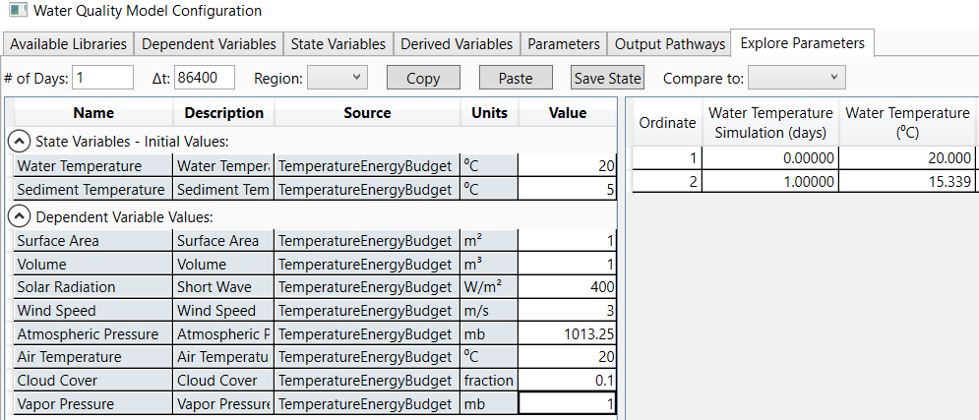
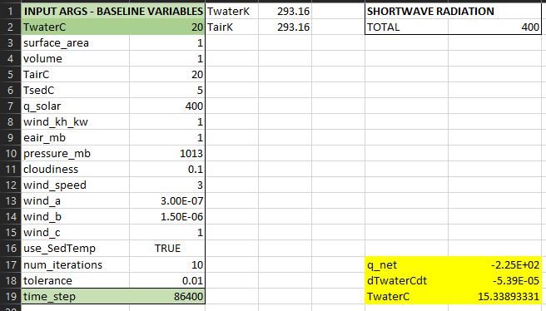
Testing TSM and Path Forward for NSM
We tested the implementation of TSM by recreating the kinetic equations in Excel as well as comparing to the Fortran water quality modules developed by ERDC and HEC for HEC-RAS (1D).

Slide 17
Framework and Model Coupling
Anthony

Slide 18




Modern Scientific Python
Built using the cloud-native geospatial Python stack being widely adopted by NOAA, USGS, NASA, etc.
An object-oriented architecture inspired by xarray-simlab / fastscape and CSDMS LandLab
Automated unit testing
https://numfocus.org/sponsored-projects
Notes:
This [modern, cloud-native, geospatial Python] stack is designed to scale computations from a single set of values to multi-dimensional arrays, as shown in the icon for the xarray package, and scale from laptop to parallel computing to distributed cloud computing, powered by the Dask library that is built-in under-the-hood for xarray. All these libraries are very well supported by foundations, industry, and federal agencies.
We also wanted to follow modern numerical modeling coding patterns in widespread use by the geosciences community, so we we organized

Slide 19


Model Coupling
Modeling community moving toward systems of coupled models from modular model components.
BMI 2.0 has become the standard for model coupling
Basic Model Interface (BMI)
Provides a common set of functions
To run models and exchange information and data on grids, variables, timesteps, etc.
Shares data among models using a zero-copy approach
Each model reads and writes to the same in-memory object using pointers
Supports models written in C, C++, Fortran, Java, Python, Javascript, Julia
NOTE: BMI must be implemented in the source code of a model before it can be used to couple that model to other BMI-compliant models
Learn more: https://bmi.readthedocs.io

Slide 20
Running Clearwater-Riverine and Clearwater-Modules Individually
Flow Field
Initial Conditions
Boundary Conditions
Topology, Volumes,
Surface Areas, Water Temp
Met Data
Initialize Riverine
Create model mesh
Initialize Modules
Create model mesh
timestep = 0
Update Timestep
Advect and diffuse
Update Timestep
Energy Budget
timestep = 1…n
repeat n times
repeat n times
Notes:
Both Clearwater Riverine and Clearwater Modules can be run on their own (users can simulate transport only or reactions only).
Highlights that these are fully de-coupled.

Slide 21
Running Clearwater-Riverine and Clearwater-Modules as Linked Models
Flow Field
Initial Conditions
Boundary Conditions
Met Data
Initialize Riverine
Create model mesh
Topology, Volumes,
Surface Areas, Water Temp
Initialize Modules
Inherit model mesh
timestep = 0
Update Timestep
Advect and diffuse
Volumes,
Surface Areas, Water Temp
Update Timestep
Energy Budget
timestep = 1…n
Water Temperature
repeat n times
Notes:
Coupling the models:
- Modules inherits the mesh and some initial conditions from Riverine
- Information is passed between the models over time (timesteps 1…n)
- Both are being developed with BMI in mind for easy coupling
- Riverine could be updated to pair with any flow field
- Modules could be coupled with any model

Slide 22
Clearwater Demonstration
Sarah

Slide 23
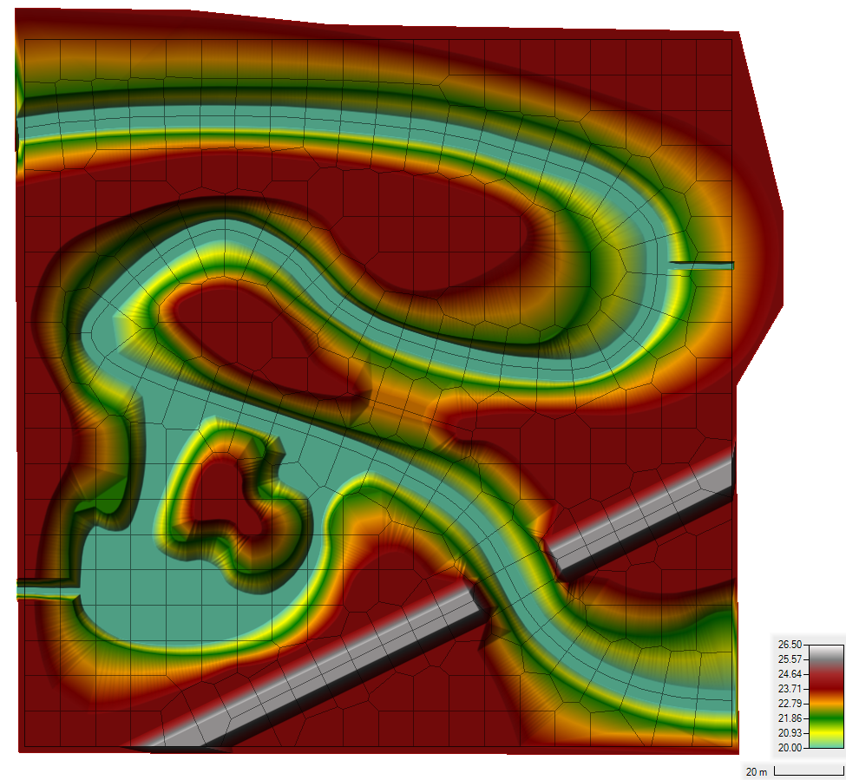
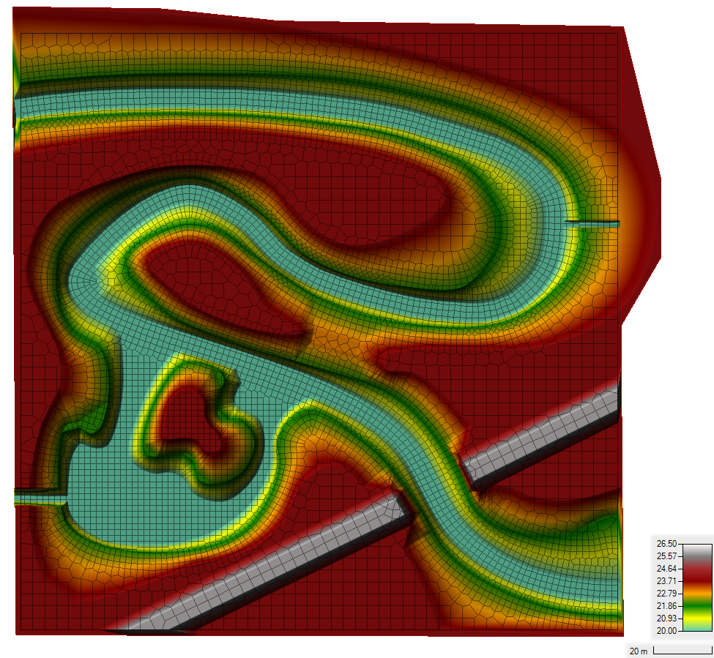
Demo Case Study: Sumwere Creek — Domain & Mesh
Coarse Mesh Fine Mesh
Notes:
Flow field is from HEC RAS-2D output in this case
Domain: 200 meters by 200 meters
Fictitious Topography/Bathymetry
- Bathymetry bottom elevation constant at 20 m
- Floodplain elevation constant at 24 m
- Roadway elevation constant at 26 m
Two Unstructured Meshes Tested
- Coarse Mesh: Base Mesh of 10 m by 10 m
- Fine Mesh: Base Mesh of 4 m by 4 m with a 2 m by 2 m refinement within the creek

Slide 24
Demo Case Study: Sumwere Creek — Hydrodynamic Boundary Conditions
Coarse Mesh Fine Mesh
Upstream: 3 cms
Spring:
1 cms
Powerplant:
0.5 cms
Downstream:
20.75 m
Notes:
HEC-RAS Boundary Conditions
- Upstream Flow for Sumwere Creek constant at 3 cms (1st hour ramping from zero)
- Downstream Stage for Sumwere Creek constant at 20.75 m
- Flow for Cold Spring Creek constant at 1 cms (1st hour ramping from zero)
- Flow for Power Plant Chute constant at 0.5 cms (1st hour ramping from zero)

Slide 25
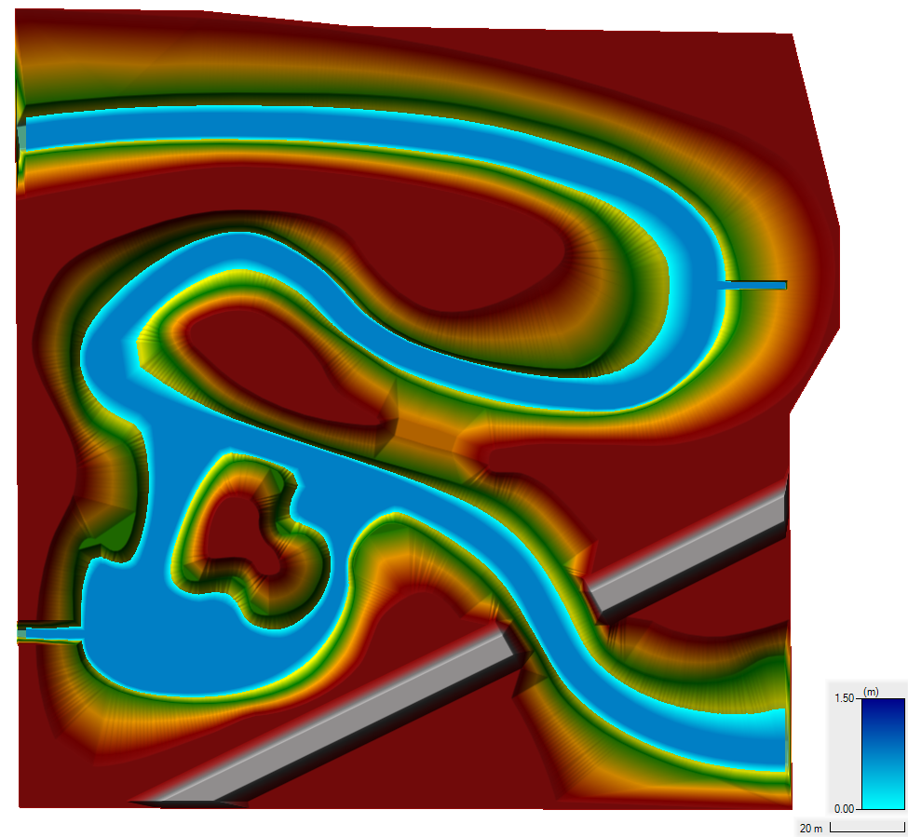

Demo Case Study: Sumwere Creek – Depth at Start of Simulation
Coarse Mesh Fine Mesh
Notes:
HEC-RAS Initial Conditions
- Initial Water Surface Elevation of 20.75 m set

Slide 26
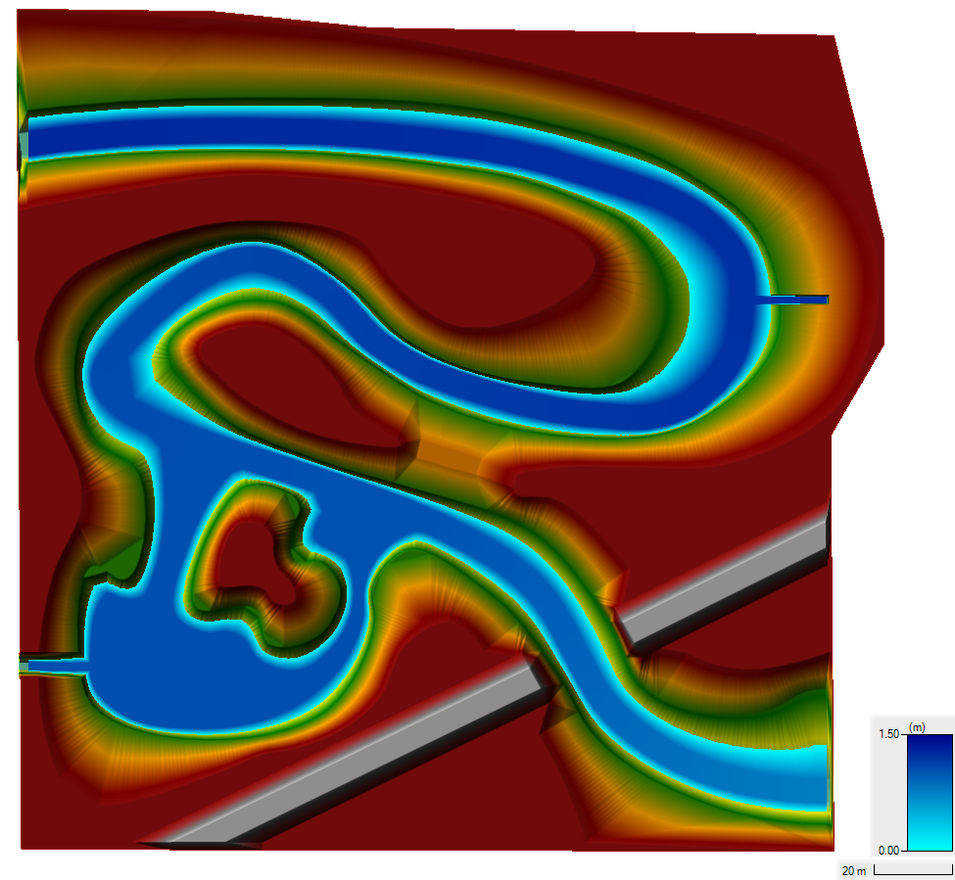

Demo Case Study: Sumwere Creek — Depth at End of Simulation
Coarse Mesh Fine Mesh
Notes:
Depth results for both meshes in plan view do not show the differences very well…

Slide 27
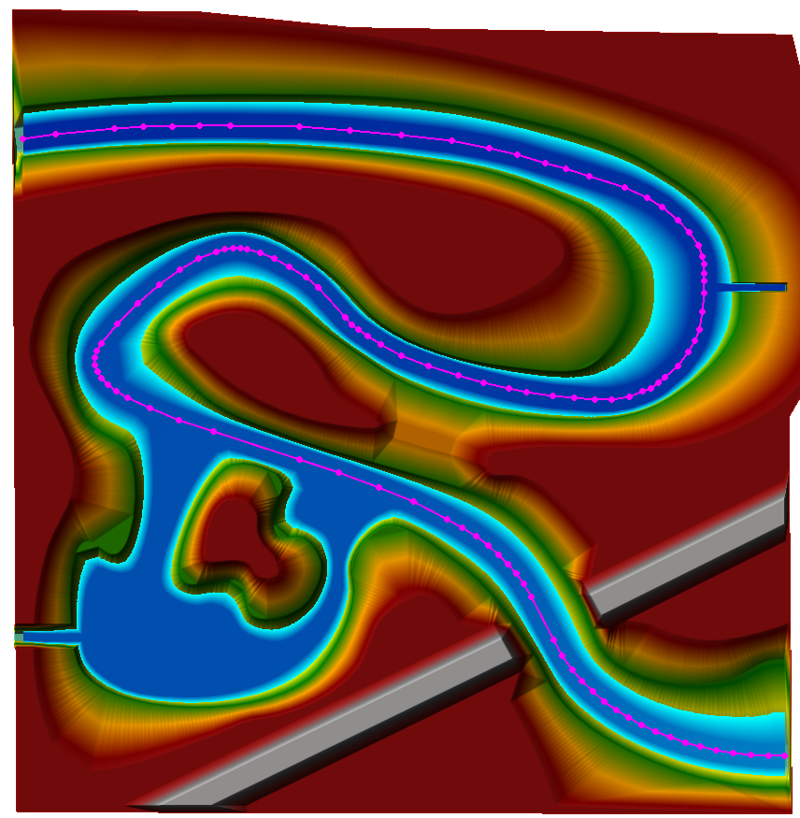
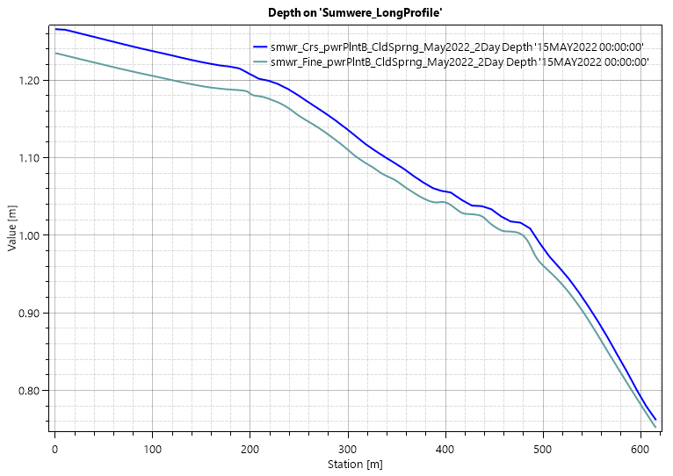
Demo Case Study: Sumwere Creek — Depth at End of Simulation
Notes:
Profile of the coarse and fine mesh depth results along the magenta line in the plan view plot.
This shows the depth at the upstream boundary at 1.27 m and 1.23 for the coarse and fine mesh, respectively (4 cm difference); these depth difference are due to mesh resolution. This shows approximately 0.5 m of hydraulic head is required to overcome the bed friction for this flow rate. A uniform Manning’s roughness coefficient of 0.06 was used in both meshes.

Slide 28
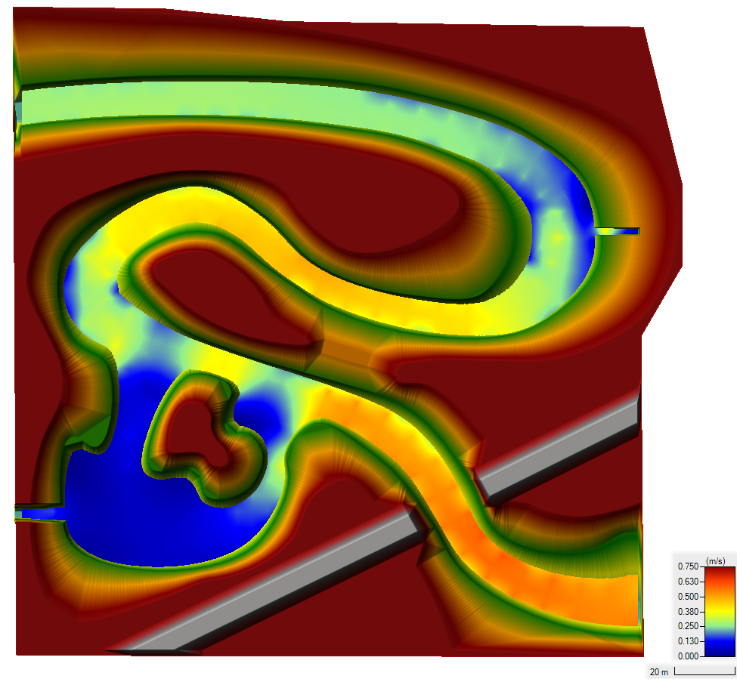
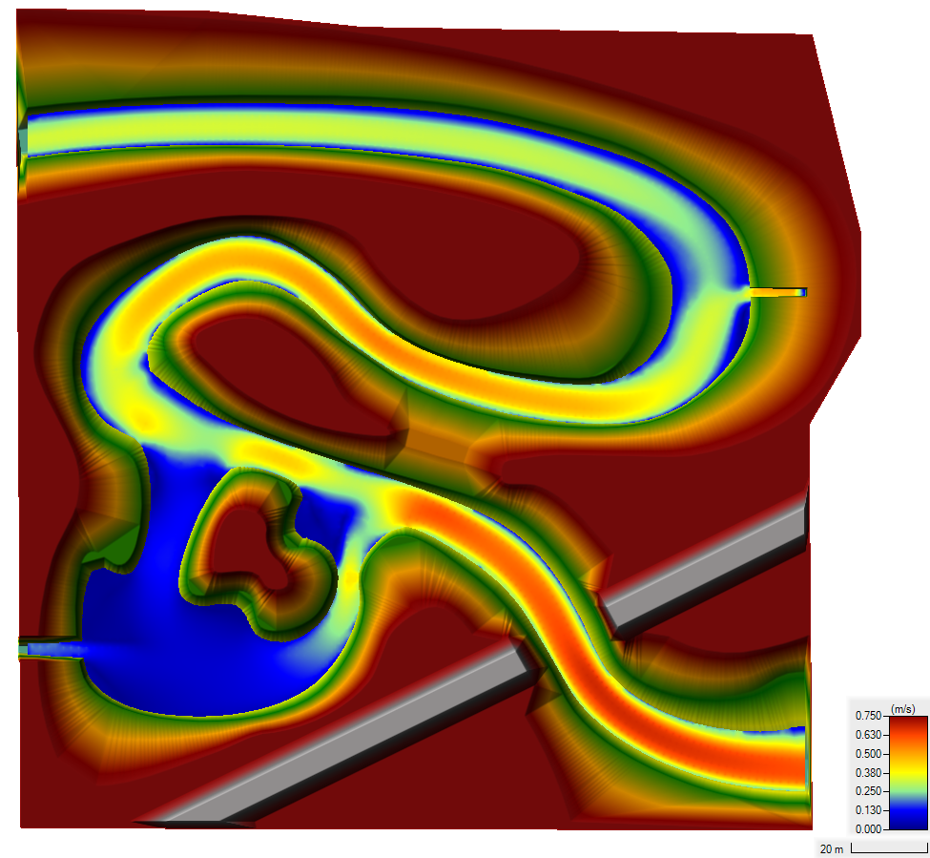
Demo Case Study: Sumwere Creek — Velocity at End of Simulation
Coarse Mesh Fine Mesh
Notes:
Differences in velocities between the meshes are due to varying spatial resolution in each mesh

Slide 29
Demo Case Study: Sumwere Creek — TSM Temperature Boundary Conditions
Coarse Mesh Fine Mesh
Upstream: 15˚C
Spring:
5˚C
Powerplant:
20-25 ˚C
Notes:
Boundary conditions are the same for both the coarse and the fine mesh.
Designed to show longitudinal mixing across the river
Exploration of different extremes (cool water from spring-fed tributary versus warm water from powerplant)

Slide 30
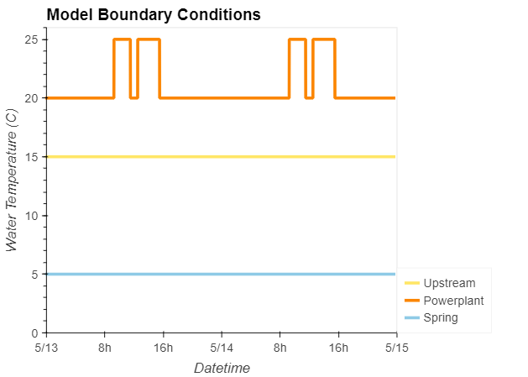
Demo Case Study: Sumwere Creek — TSM Temperature Boundary Timeseries
Coarse Mesh
Upstream: 15˚C
Spring:
5˚C
Powerplant:
20-25 ˚C
Notes:
Timeseries of boundary conditions (stable, except for powerplant discharge)
Powerplant discharge has two peaks during the day (one in the morning, one in the afternoon)

Slide 31
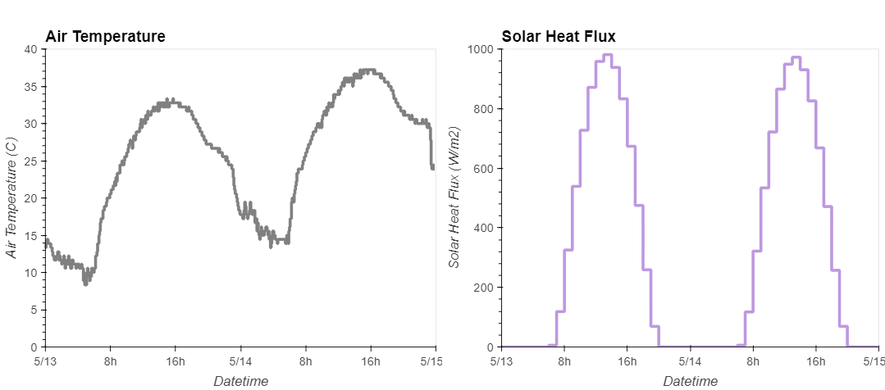
Demo Case Study: Sumwere Creek — TSM Meteorological Timeseries
Notes:
Meteorological timeseries used as inputs to TSM.
Air temperature and solar heat flux both peak during the day and drop at night.
Timeseries from Arizona (extreme cycles to help capture impact of TSM).

Slide 32

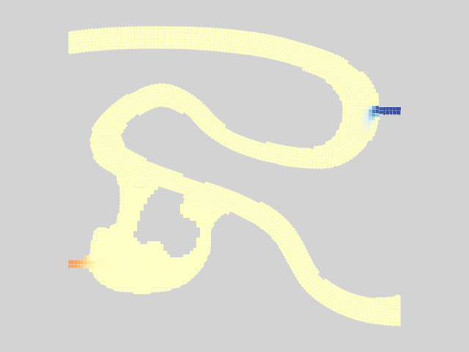
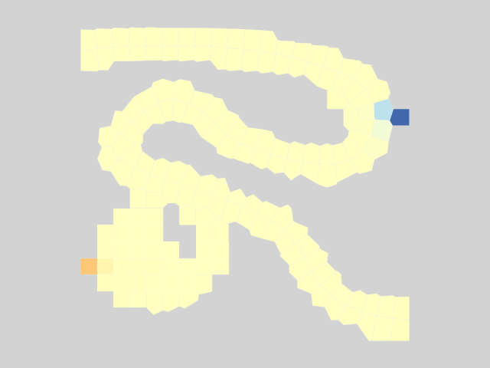
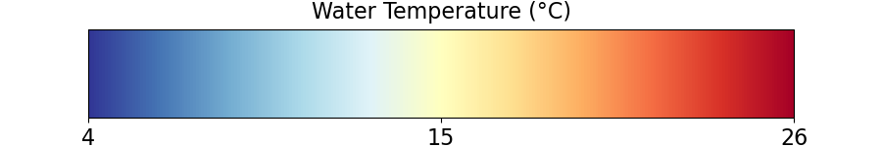
Results – Model Spin-Up
Coarse Mesh Fine Mesh
Notes:
Some model spin-up to reach steady-state conditions.
Set initial conditions to 15C everywhere.

Slide 33
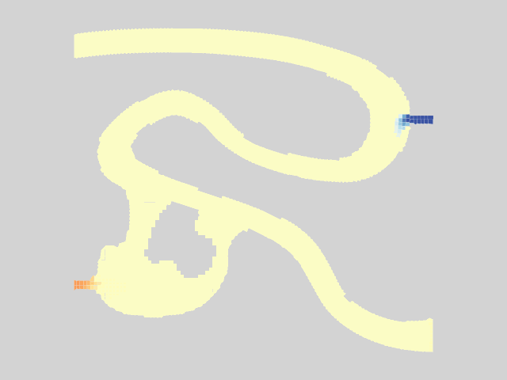

Results – Model Spin-Up
Coarse Mesh Fine Mesh
Notes:
You can see the mixing.
Ultimately reaches steady state.

Slide 34
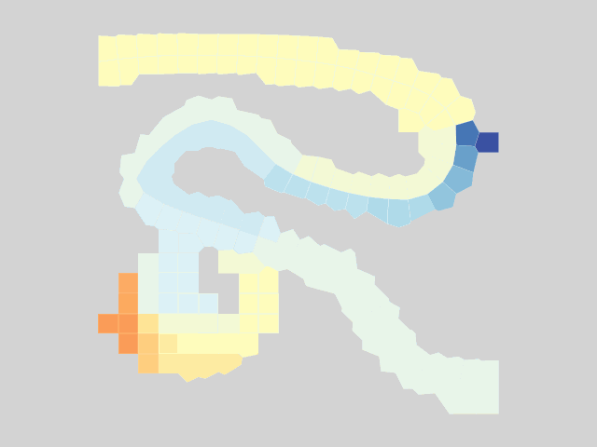
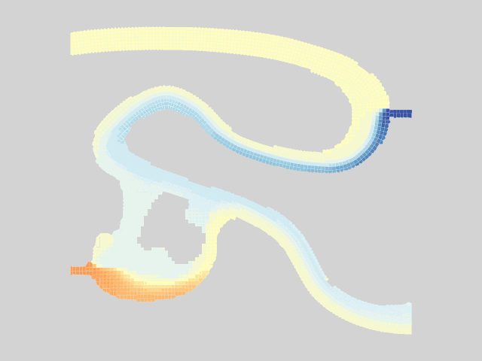

Results – Warm Powerplant Inflows
Coarse Mesh Fine Mesh
Notes:
Pulses from powerplant.
Can see a lot more transverse mixing from the powerplant and spring in the fine mesh compared to the coarse mesh.
Can see more detail on the plume of warm water.
This all shows transport very clearly, but what about our energy budget model / TSM?

Slide 35
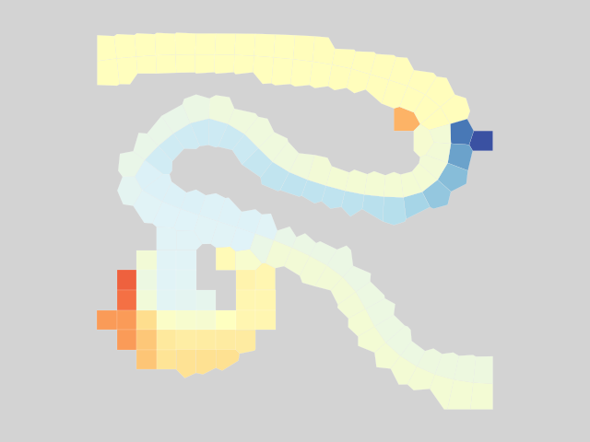
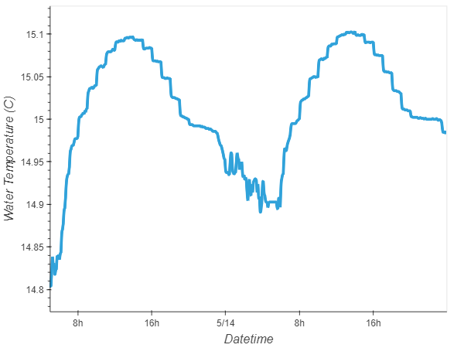
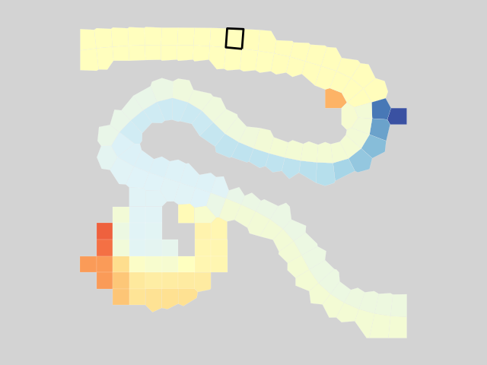
Results – Impact of TSM
TSM: cyclical rise and fall of water temperature (solar heat flux, air temp)
Coarse Mesh
Upstream: 15˚C
Notes:
Let’s take a look at a single cell. We have steady boundary conditions upstream, so without TSM, water temperature would also be steady over time
But we are coupling with TSM, so we see the cyclical rise and fall of water temperature due to our changes in solar heat flux and air temperature.

Slide 36
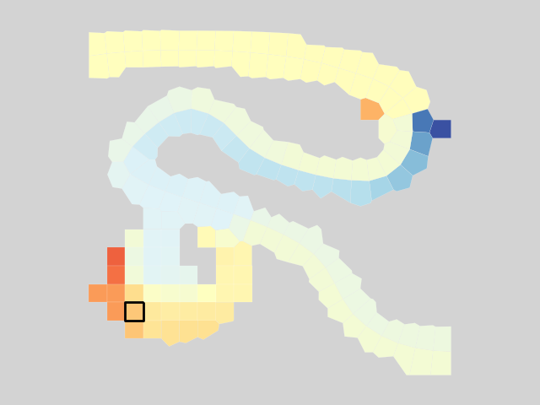

Results – Impact of TSM
TSM: impacts are still apparent in downstream mixing zones
Coarse Mesh
Powerplant: 20-25˚C
Notes:
The impacts of TSM are apparent even in mixing zones
Dominant visual is the peaks from powerplant discharges, but you can see the daily rise and fall still as an underlying trend.

Slide 37



Results – Interactive Visualization
Python framework allows easy integration with powerful interactive visualization packages
Enhanced understanding of complex environmental/ecological outcomes
Iterative analysis and scenario discovery
Multidimensional exploration across time and space
Effective communication of results across teams and stakeholders
source
Notes:
Building on the shoulders of giants.
We do not build or maintain any of these libraries.

Slide 38


Results – Interactive Visualization Live Demo
Notes:
Live demo; Sarah to screen share.

Slide 39

Summary
ClearWater was expanded to simulate nutrient and temperature flow
Flexible framework designed to link:
Water Quality models
Vegetation models
Water Resources models
HEC-RAS (2D)
GSSHA
Demonstration showed simulation of heat transport in a complex riverine system

Slide 40

Benefits
Improved understanding of how nutrient dynamics influence species distribution patterns
Informs invasive species management
Enhanced ability to predict and develop targeted ecosystem restoration strategies based on nutrient availability and species responses
Better insights into the role of nutrient cycling in ecosystem functioning (e.g., primary productivity)
Supports informed management decisions
Improves prediction of carbon cycling (e.g., supports carbon sequestration analyses)

Slide 41

Implications for Next Generation Ecological Modeling
Model linking using BMI enables a seamless exchange of data and information between different components of the integrated modeling system.
Facilitates data-driven decision-making
Enhances collaboration between scientific disciplines
Integrated models that simulate the interactions between heat, nutrients, water flow, and vegetation enable a comprehensive representation of ecosystem dynamics.
Accurate representation of real-world processes
Enables assessment of the ecological responses to various environmental changes, such as land use modifications, climate change, or nature-based feature design and Best Management Practices (BMPs)
Example applications:
Setting nutrient loading limits
Designing buffer zones
Implementing BMPs to restore aquatic ecosystems

Slide 42

Questions?

